Slide 1




ecoSolv Products
Distributed by
Fortis Solutions LLC

Slide 2
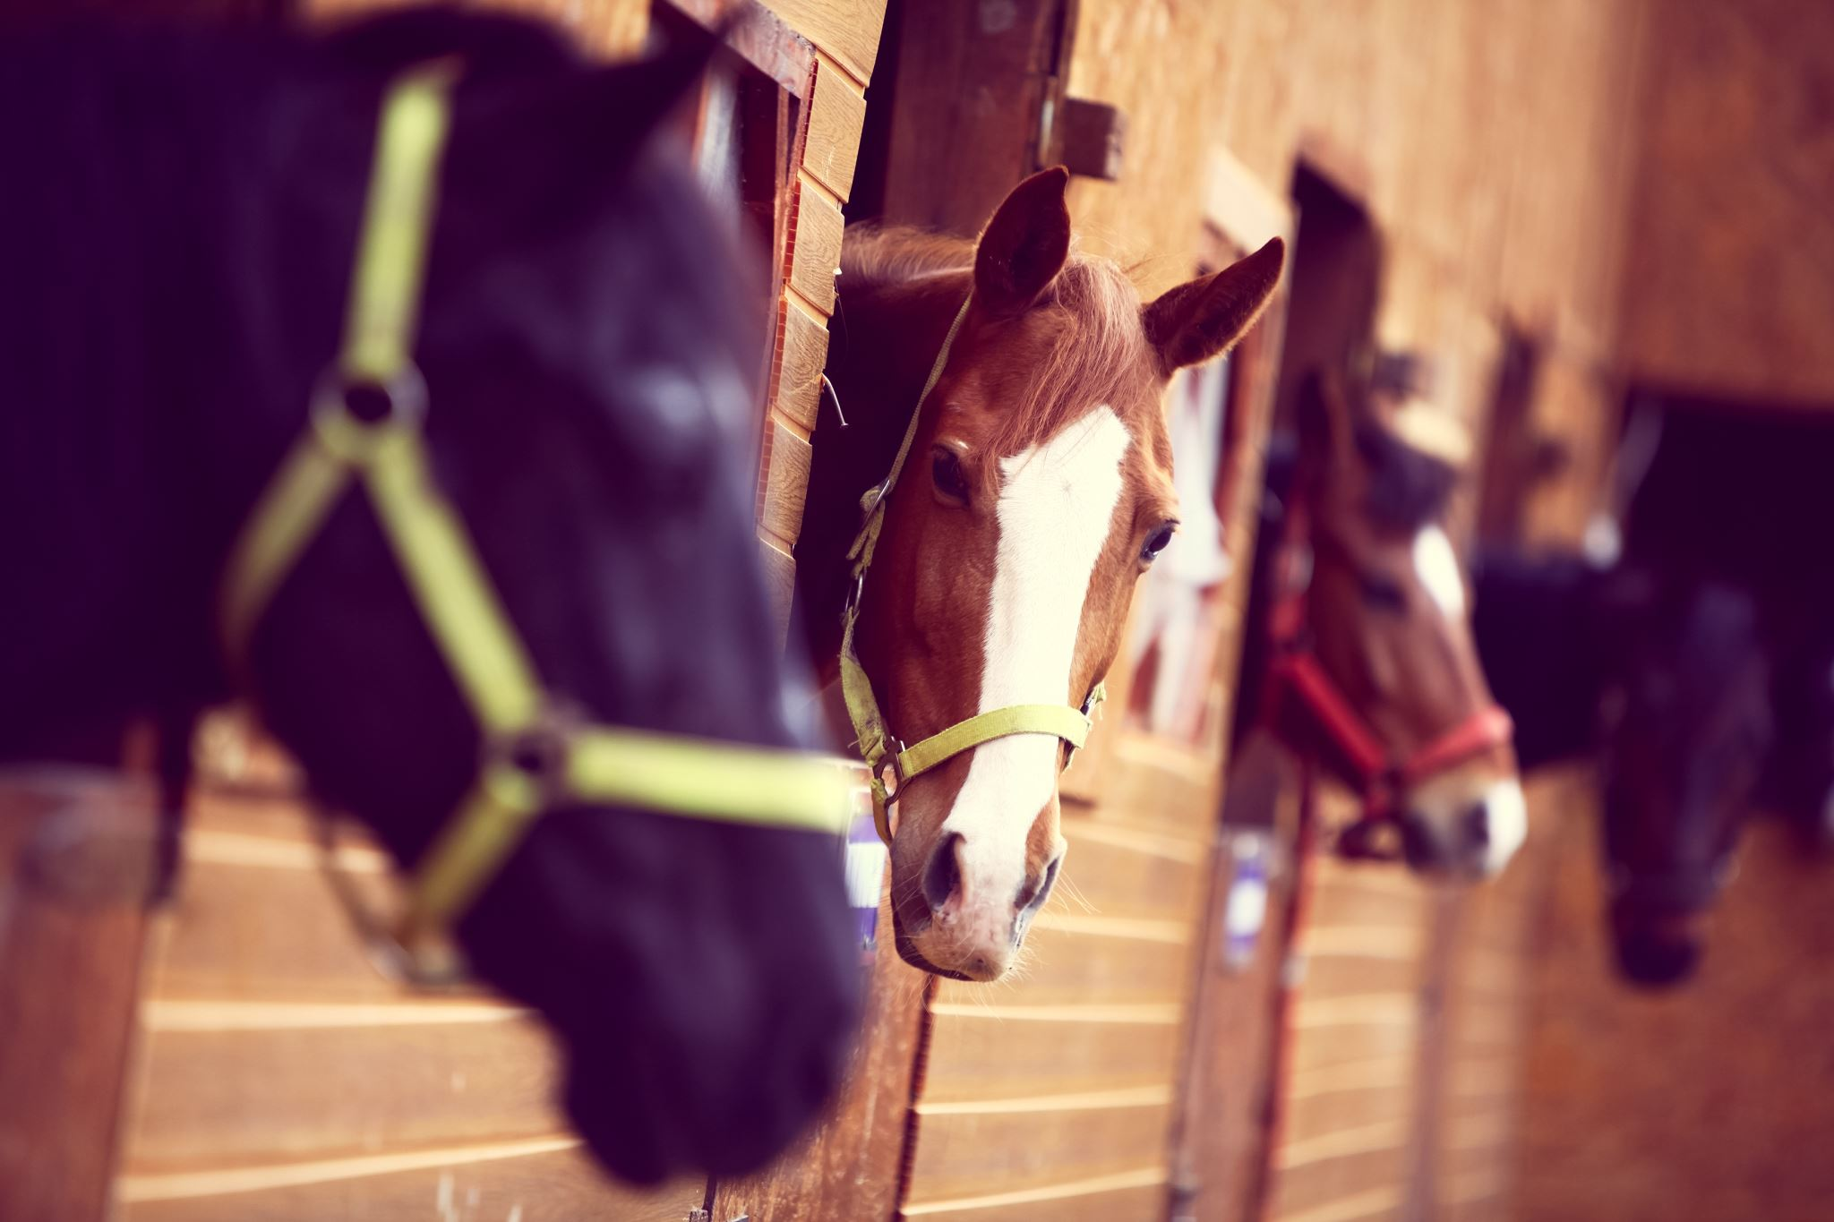
eQuine Wash
From Renewable Natural Resources
eQ100 penetrates deep
to loosen and remove dirt, skin debris and dandruff
while gently cleaning the coat, mane and tail.
Enhances the coats natural colors
leaves coat soft with a beautiful sheen.

Slide 3
eQuine Wash Cont.
Non-Toxic
Non-Carcinogenic
Hypoallergenic
Non-Corrosive
Non-Hazardous
Non-Caustic
Non-Fuming
Low-Foaming
Non-Flammable
Formulated 100% from North American Plant Extracts

Slide 4
eQuine Wash Cont.
eQ100 is a high-performance animal cleanser
hypoallergenic
non-toxic
noncarcinogenic
and thorough cleaning for horses
farm animals and pets
It contains no dyes or artificial perfumes and is made 100% from North American plant extracts

Slide 5
eQuine Wash Cont.
Super Cleansing for
General Bathing
Hot Spots
Dermatitis
Eczema
Thrush
Rain Rot
Mud Foot
Cracked Heel
Scratches
Summer Itch
Nicks and Cuts
Abrasions
Sensitive Skin
Skin Allergies
Flea Bites
Sun Burn
Clipper Irritation

Slide 6
eQuine Wash Cont.
Topical Uses to promote the healing of
Hot Spots
Dermatitis
Eczema
Thrush
Rain Rot
Mud Foot
Cracked Heel
Scratches
Summer Itch
Scratches, Nicks and Cuts, and Abrasions

Slide 7
eQuine Wash Cont.
Not Found In eQ100: Ozone Depleting Substances Synthetics Terpenes Petroleum Distillates Glycol Ethers Caustic Builders & Reagents
Removes all food sources and odors that attract mites and dwelling insects!

Slide 8
How to Order
Troy A. Price President Fortis Solutions LLC.
Tprice@fortissolutionllc.com
571-356-0534

